Slide 1




Swiggy Data
Analysis

Slide 2
Meet Our Best Team
Batch:- BI V14-B (AWS + Python + PySpark) PT Sep 3rd Batch BLR
Kushagar Bansal
Nimit Gupta
30013584
kushagar.bansal@capgemini
30013499
nimit.gupta@capgemini
Namann Luthra
Shagun Vohra
30013567
namann.luthra@capgemini
30013491
shagun.vohra@capgemini

Slide 3



Problem Statement
To analyze restaurant popularity in specific localities within cities. We will collect and evaluate data based on several key attributes, including
City
Cuisines
Numerical and Textual Ratings
Average Cost for Two
Table Availability
Online Booking Options

Slide 4
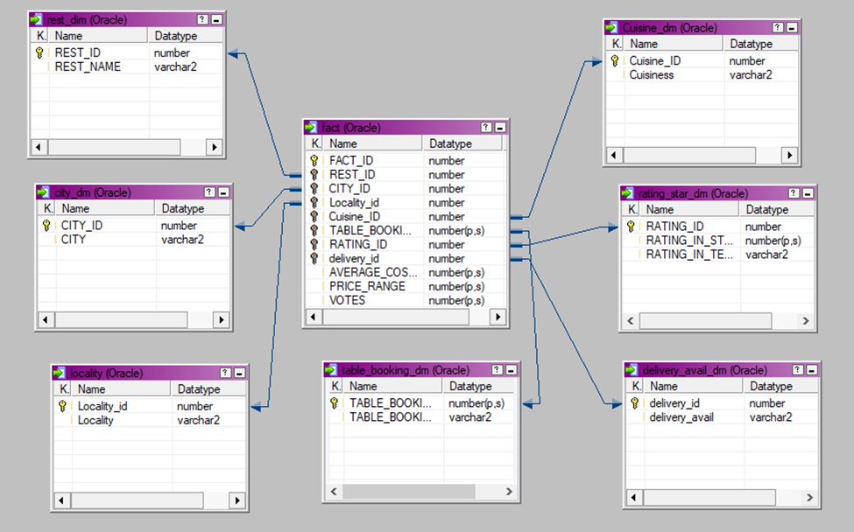
Project Schema

Slide 5


Targeted Deliverables
Count of Restaurant city wise
City-wise Top 10 restaurant based on Avg cost for 2
Top 10 restaurant based on Avg Votes
Top 10 restaurant based on Rating City wise
Rating based on delivery availability City wise
Avg cost for 2 based on cuisine city wise

Slide 6

Targeted Results

Slide 7
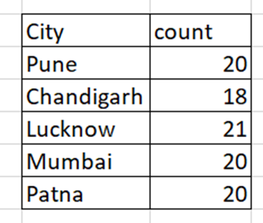
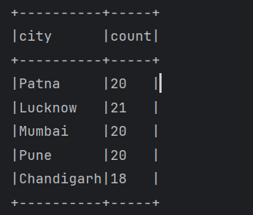
Count of Restaurant city wise
Expected Output
Actual Output

Slide 8
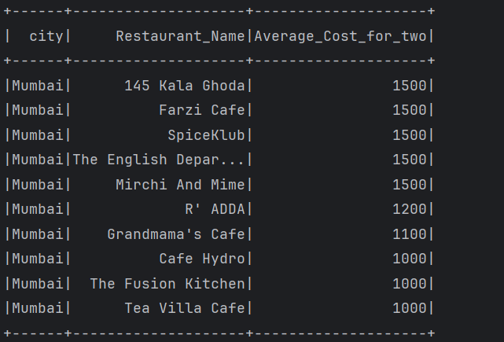
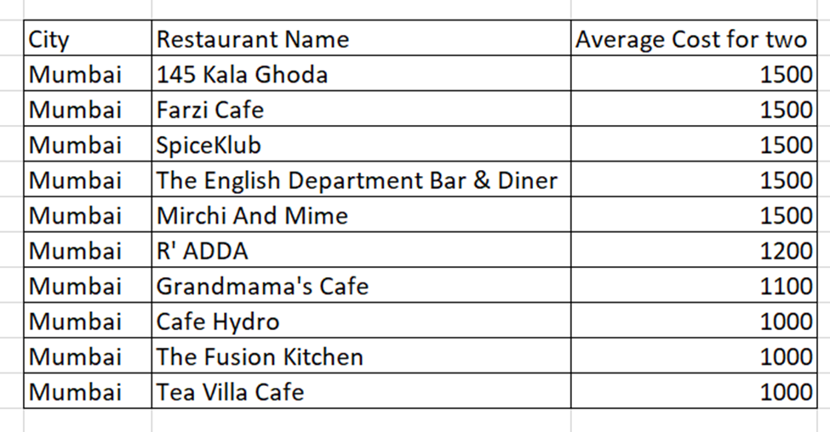
City-wise Top 10 restaurant based on Avg cost for 2
Expected Output
Actual Output

Slide 9
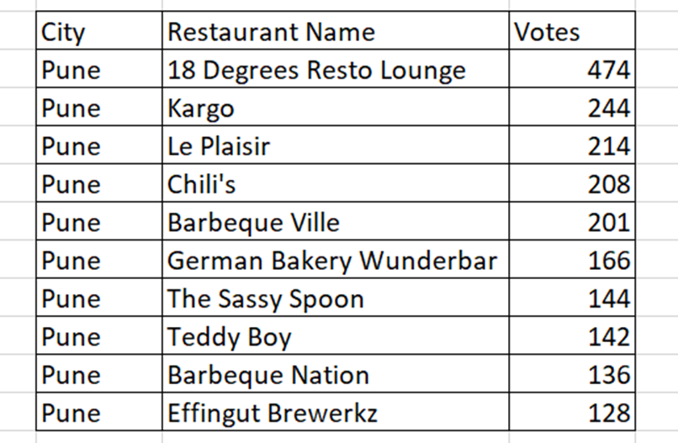
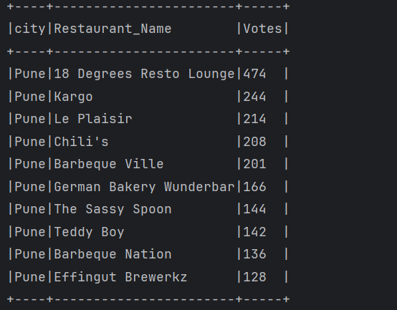
Top 10 restaurant based on Avg Votes
Expected Output
Actual Output

Slide 10
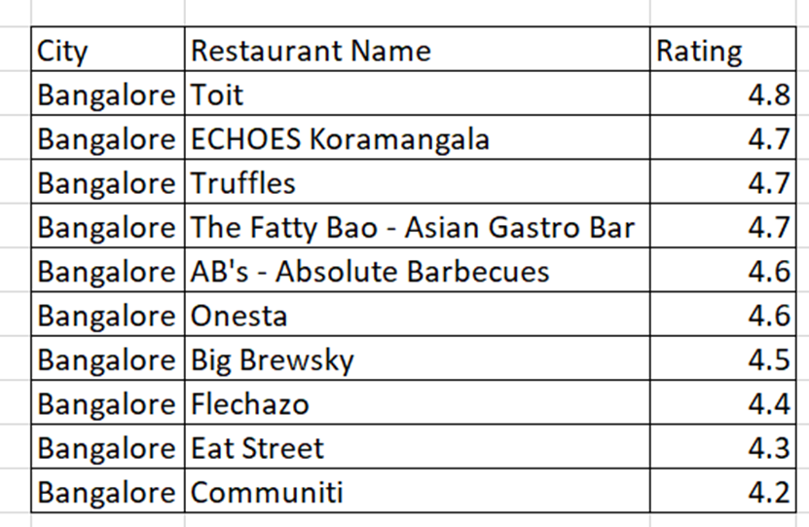
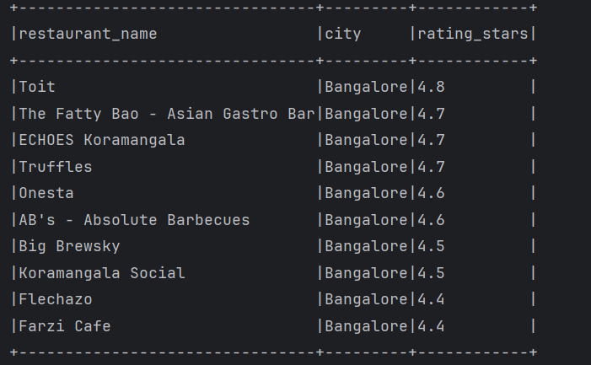
Top 10 restaurant based on Rating City wise
Expected Output
Actual Output

Slide 11
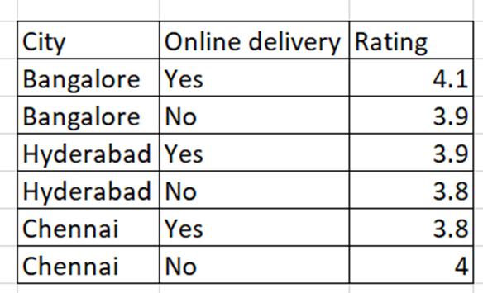
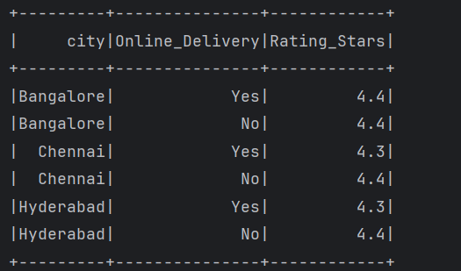
Rating based on delivery availability City wise
Expected Output
Actual Output

Slide 12
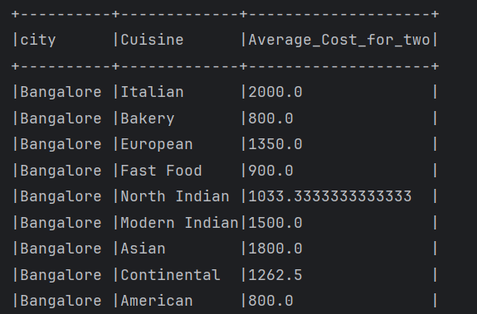
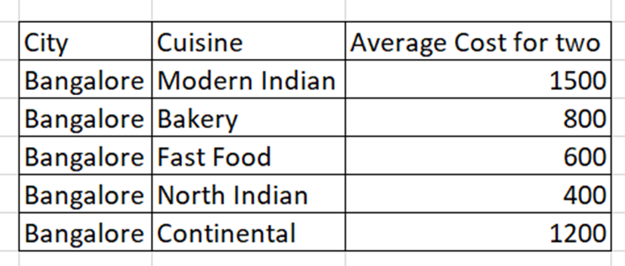
Avg cost for 2 based on cuisine city wise
Expected Output
Actual Output

Slide 13


Slide 14


